Slide 1
Computer Vision and Image Processing
Tirgul 5
Convolution
By Shai Aharon & Moriya Bitton

Slide 2
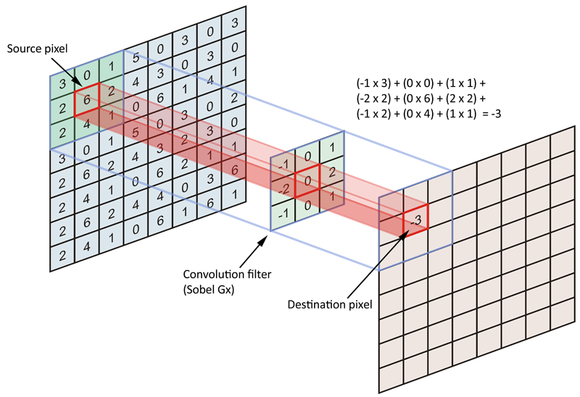
Filters

Slide 3
Convolution
A linear operator that acts as an average / weighted average sum on all pixels in a given environment.
Used for:
Blur: Replaces each pixel in its average environment.
Moving pixels
Edge detection in the image: Replacing each pixel with the difference of its neighbors.

Slide 4
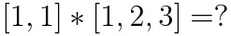
1D Discrete Convolution
The convolution idea:
Take a vector
Flip it
Move it over the other vector
Multiply the values

Slide 5
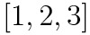
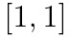
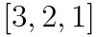
1D Discrete Convolution
The convolution idea:
Take a vector
Flip it
Move it over the other vector
Multiply the values

Slide 6
1D Discrete Convolution
The convolution idea:
Take a vector
Flip it
Move it over the other vector
Multiply the values

Slide 7
1D Discrete Convolution
The convolution idea:
Take a vector
Flip it
Move it over the other vector
Multiply the values

Slide 8
1D Discrete Convolution
The convolution idea:
Take a vector
Flip it
Move it over the other vector
Multiply the values

Slide 9
1D Discrete Convolution
The convolution idea:
Take a vector
Flip it
Move it over the other vector
Multiply the values

Slide 10
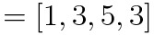
1D Discrete Convolution
The convolution idea:
Take a vector
Flip it
Move it over the other vector
Multiply the values

Slide 11
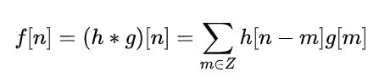
1D Discrete Convolution
In practice, outside the boundaries of the vector, we consider it to be zero and don’t calculate it.

Slide 12
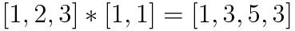
1D Discrete Convolution - Warmup
?
?
?
?

Slide 13
1D Discrete Convolution - Warmup
?
?
?

Slide 14
1D Discrete Convolution - Warmup
?
?

Slide 15
1D Discrete Convolution - Warmup
?

Slide 16
1D Discrete Convolution - Warmup
Weighted Mean
Mean

Slide 17
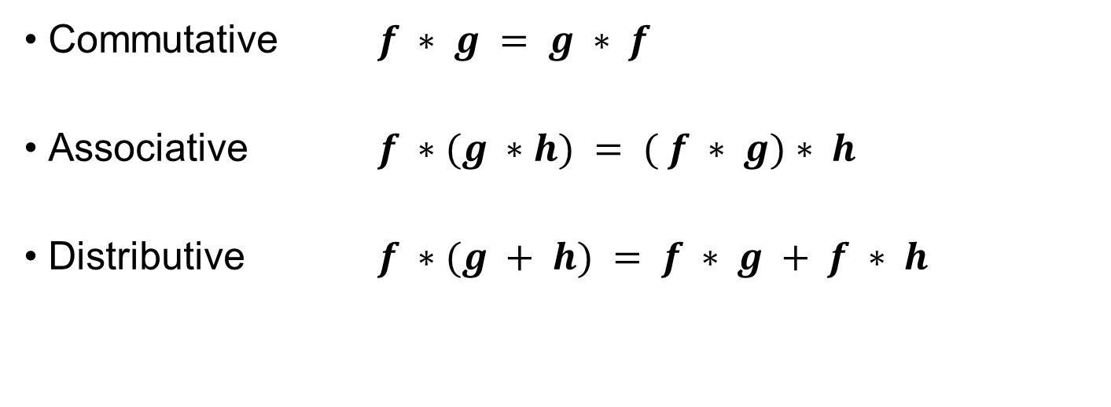
Convolution Properties:
• Commutative $f ∗ g = g ∗ f$ • Associative $f ∗(g ∗h) = ( f ∗ g)∗ h$
• Distributive $f ∗(g + h) = f ∗ g + f ∗ h$

Slide 18
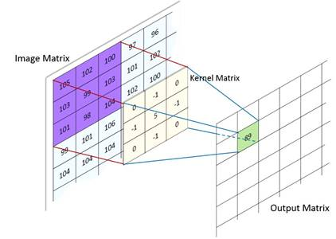
2D Convolution
Same thing, but in 2D!
After flipping the kernel (conv. matrix)
you “place” it on the image (the center is at (x,y))
Multiply each cell in the kernel with its parallel cell in the image matrix
Sum all the multiplicities and place the sum in the output matrix at (x,y)

Slide 19
2D Convolution- Example
img_path = 'scarlet_witch.png'
img = cv2.cvtColor(cv2.imread(img_path), cv2.COLOR_BGR2RGB)
k_size = 11
kernel = np.ones((k_size, k_size))
kernel /= kernel.sum() # Normalize the kernel such that k.sum()==1
img_blur = cv2.filter2D(img, -1, kernel)
cv2.filter2d does Correlation and not Convolution!

Slide 20
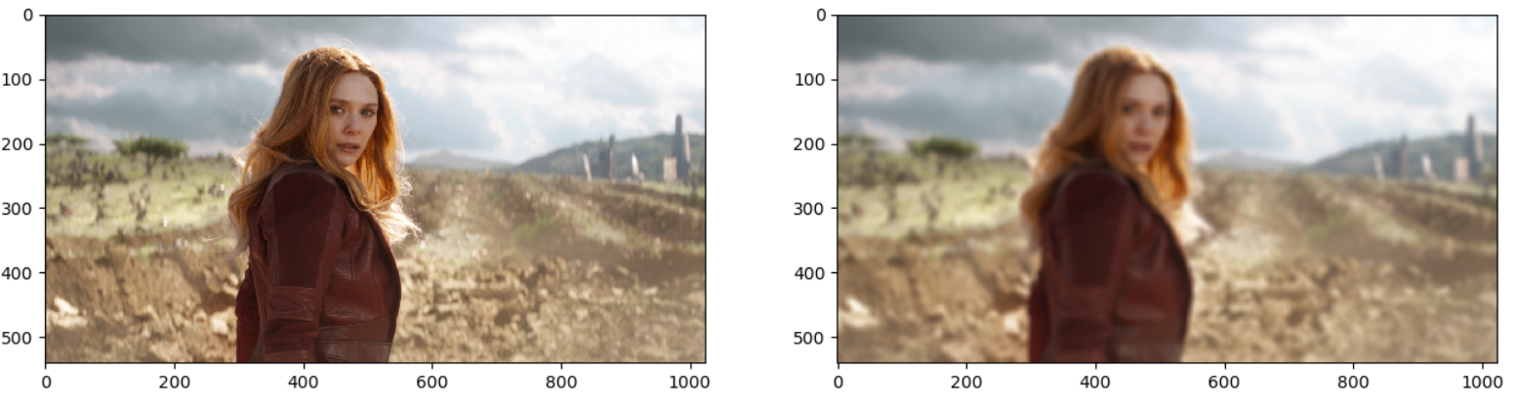
2D Convolution
img_path = 'scarlet_witch.png'
img = cv2.cvtColor(cv2.imread(img_path), cv2.COLOR_BGR2RGB)
k_size = 11
kernel = np.ones((k_size, k_size))
kernel /= kernel.sum()
img_blur = cv2.filter2D(img, -1, kernel)

Slide 21
2D Convolution
img_path = 'scarlet_witch.png'
img = cv2.cvtColor(cv2.imread(img_path), cv2.COLOR_BGR2RGB)
k_size = 11
kernel = np.ones((k_size, k_size))
kernel /= kernel.sum()
img_blur = cv2.filter2D(img, -1, kernel)
One can say she 'Lost her vision'

Slide 22

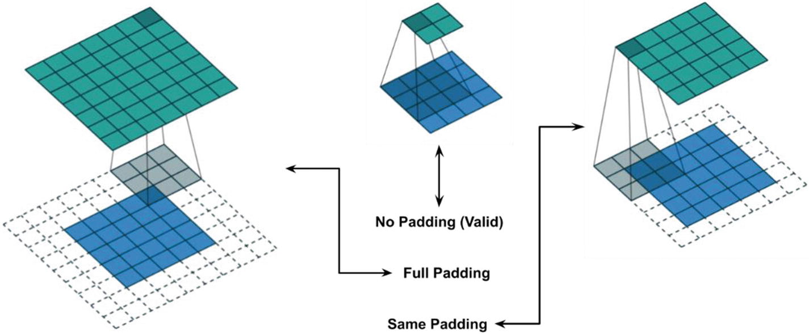

Output size
Valid →
Same →

Slide 23
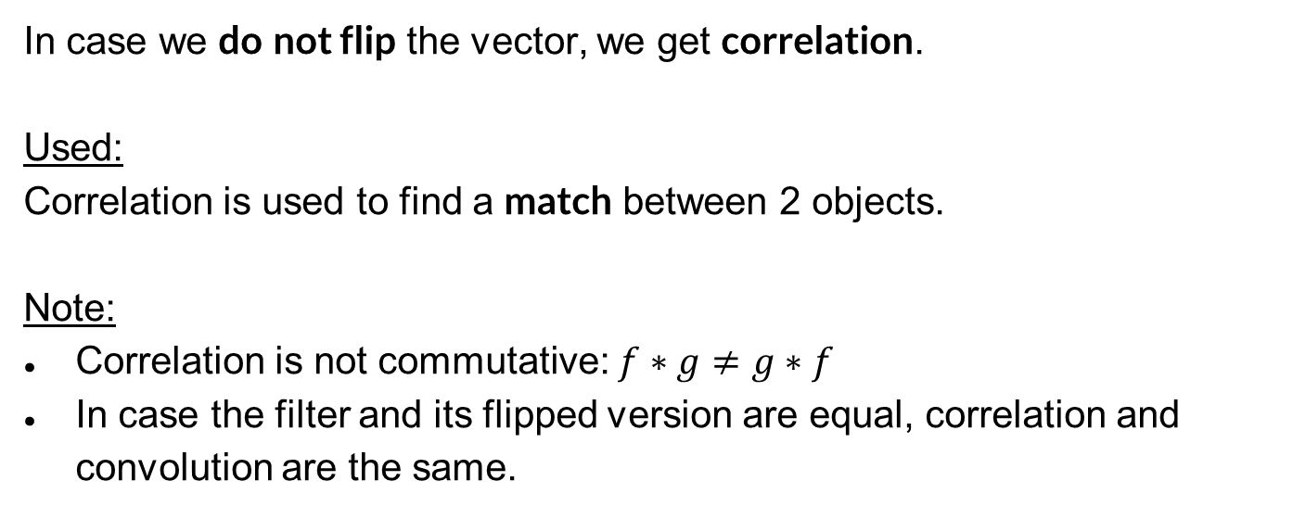
Correlation
In case we do not flip the vector, we get correlation.
Used:
Correlation is used to find a match between 2 objects.
Note:
Correlation is not commutative: $f∗g≠g∗f$
In case the filter and its flipped version are equal, correlation and convolution are the same.

Slide 24
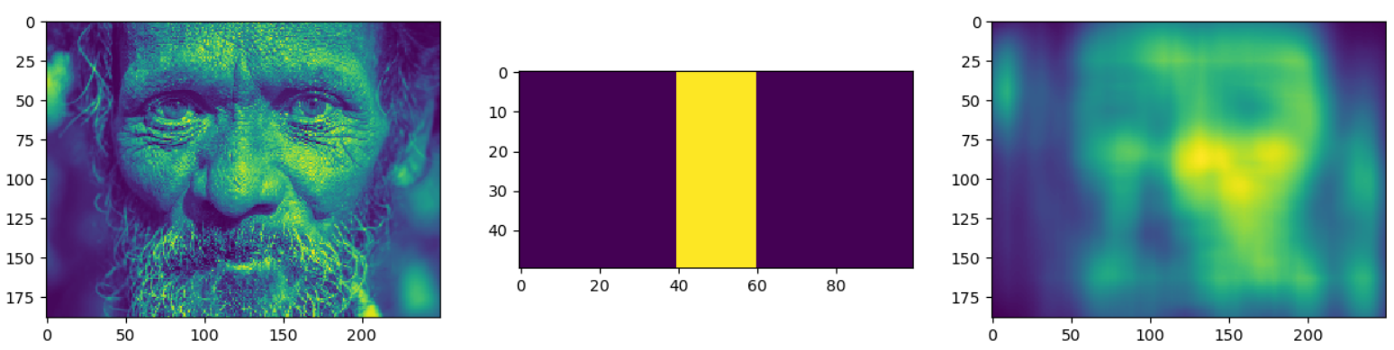
Template Matching
One use for correlation, is locating a ‘mini-image’ (Template) inside an image.
Kernel
Image

Slide 25
Template Matching
One use for correlation, is locating a ‘mini-image’ (Template) inside an image.
Correlation

Slide 26
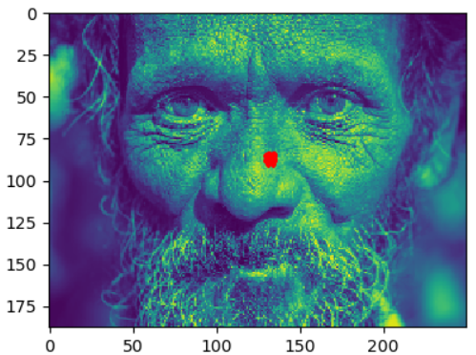
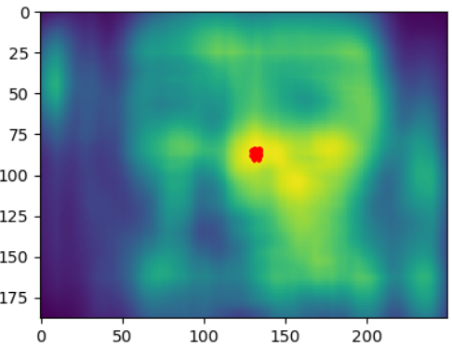
Template Matching
One use for correlation, is locating a ‘mini-image’ (Template) inside an image. For more info on face detection: Viloa Jones 2001

Slide 27
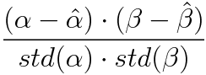
Template Matching
Problem:
Most of the times, the image will be noisy, different lighting etc. and we won’t have the option to tailor our template like before.
Solution:
We’ll use Normalized Cross Correlation.
This calculation will be done for every window, and will take much longer.

